Slide 1


Welcome To Digital Book
Presenting by Krutibas Lenka

Slide 2



Agenda
The term “Digital Book” is used to describe all the measures required or planned for a systematic approach to shaping the digital transformation of a particular system.

Slide 3




Introduction
An eBook (Electronic Book; E-Book; Digital Book) is the digital version of a printed book, or a full length book text that is published or converted to digital format to be viewed on the computer, dedicated ebook readers and Mobile phoneS

Slide 4

Components
Home Page
Author Login & Signup
Create Book
Search Book
Buy Book
Invoice Of Payment

Slide 5
Home Page
This is the Home page, here reader and can see the all books. In the home page all components are available.

Slide 6
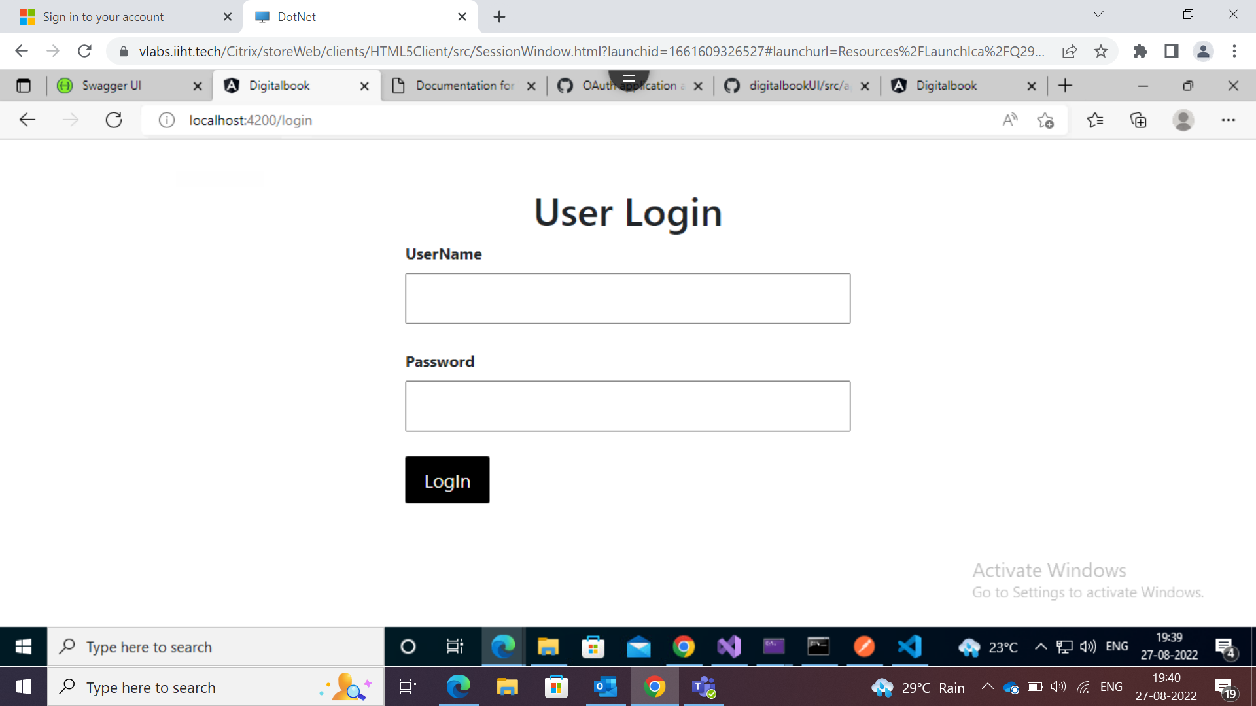
LogIn Pge
This is the Login page. Here only access for Author.

Slide 7
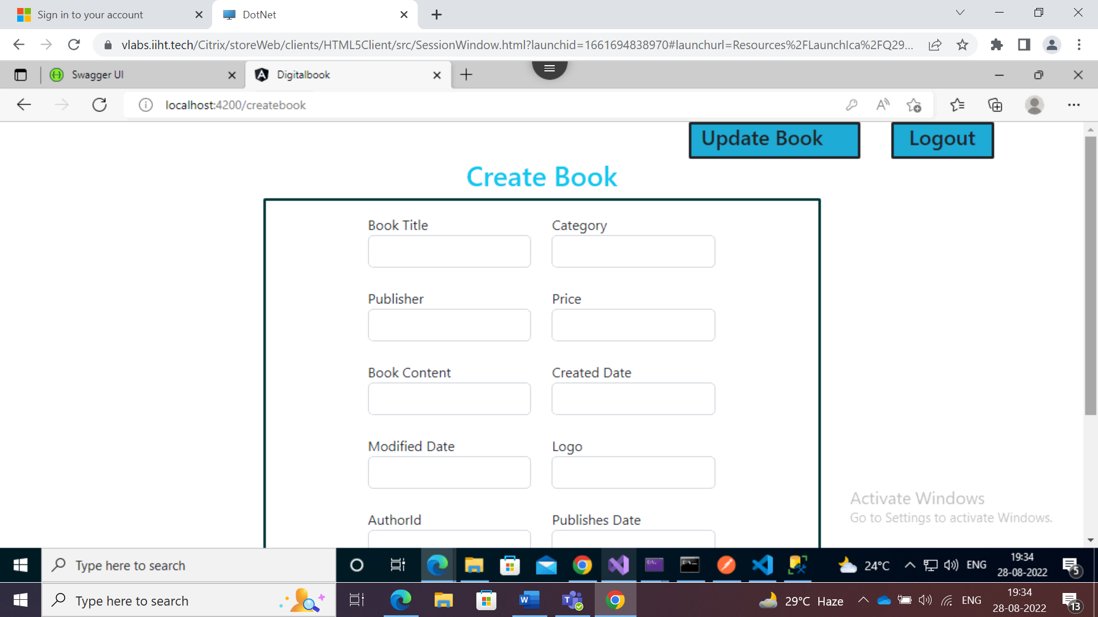
After Login Author can access to this page. Here Author can create a book and update the book.

Slide 8
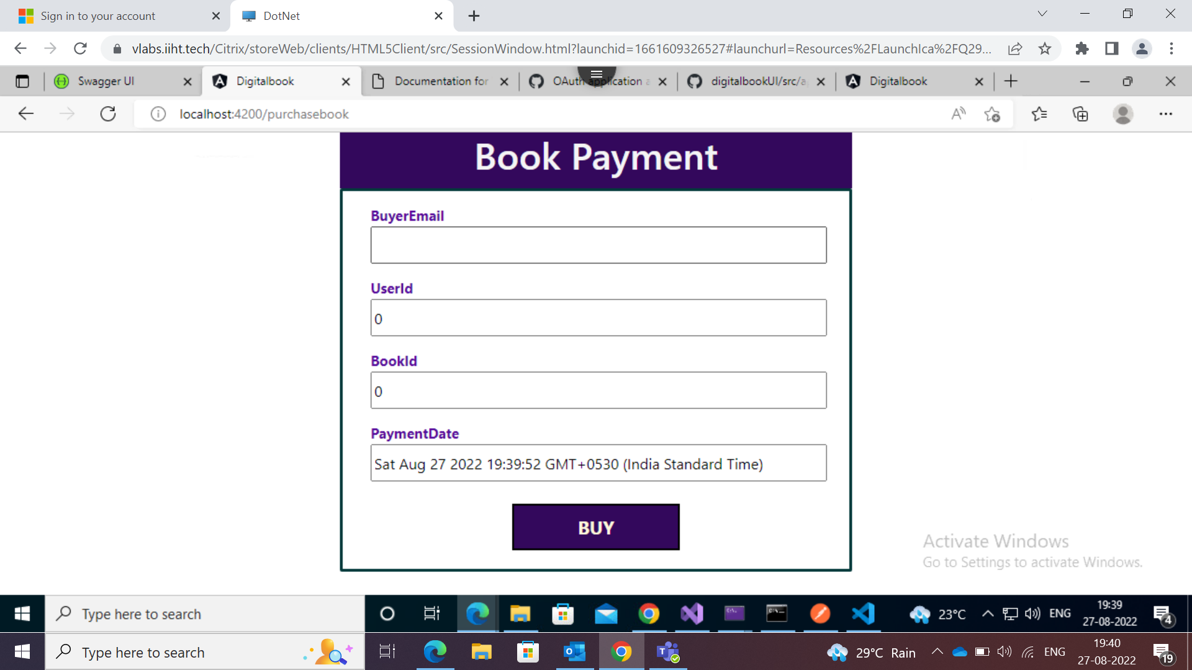
For this page no need of access. Here Reader can buy the book.

Slide 9
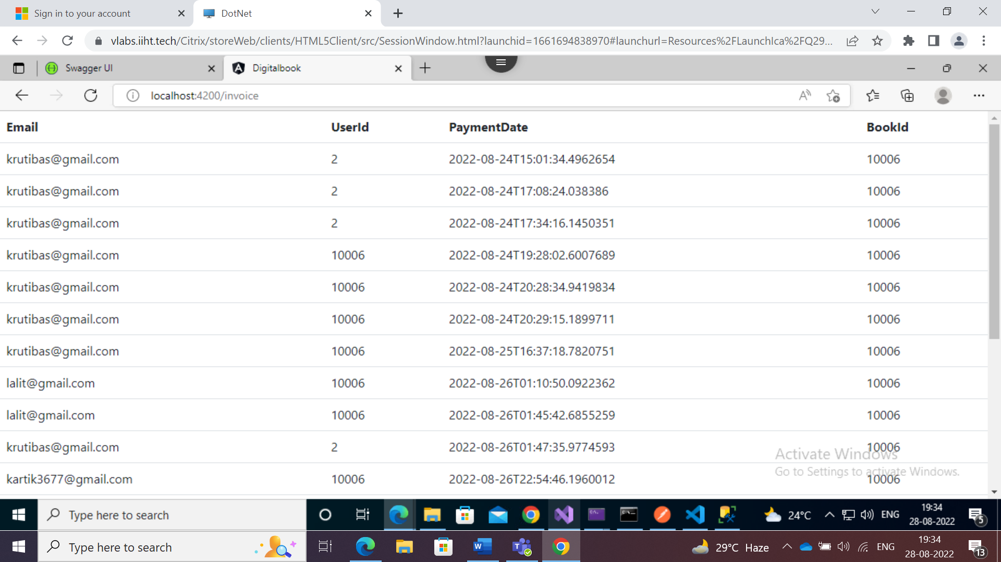
After payment , here user can get the invoice of the payment.

Slide 10
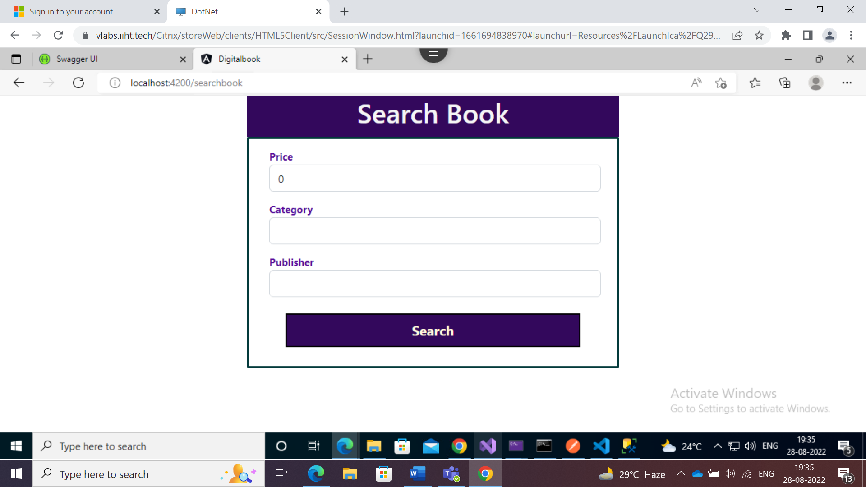
Here Reader can search the book using these fields.

Slide 11


Thank You
Krutibas Lenka

